Slide 1

ENGINEERING CHEMISTRY
Asha A
Department of Science and Humanities

Slide 2

ENGINEERING CHEMISTRY
Module I- Molecular Spectroscopy
Class content:
Intensity of spectral lines
Franck Condon Principle

Slide 3
Electronic spectroscopy
ENGINEERING CHEMISTRY
Module I- Molecular Spectroscopy
Intensity of spectral lines
There are no selection rules for vibrational changes during an electronic transition
Most of the transitions start from v”=0 as it is most populated level
The excited state usually has longer internuclear distance because of antibonding character
3
2
1
ε’
v’=0
E
4
3
2
1
ε”
v”=0
r

Slide 4
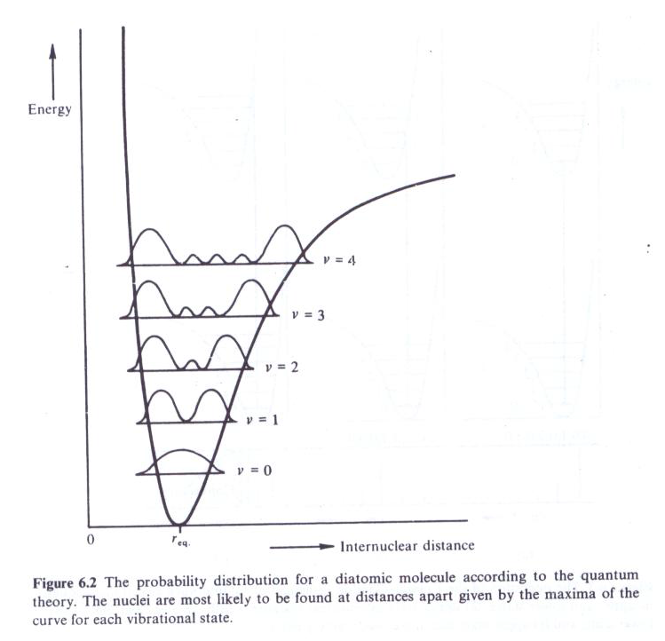
ENGINEERING CHEMISTRY
Module I- Molecular Spectroscopy
The transitions arise from the centre of v”=0 because the maximum probability of finding the nuclei is at the centre of v”=0
Source:Fundamentals of Molecular Spectroscopy: C. N. Banwell and Elaine M McCash, Fifth Edition, MCGRAW-HILL Education (India) Private Ltd.
Probability distribution for a diatomic molecule according to quantum theory

Slide 5
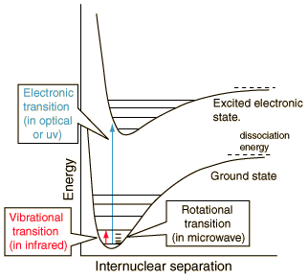
ENGINEERING CHEMISTRY
Module I- Molecular Spectroscopy
Energy level diagram for a diatomic molecule
Source: http://hyperphysics.phy-astr.gsu.edu/hbase/molecule/molec.html

Slide 6
ENGINEERING CHEMISTRY
Module I- Molecular Spectroscopy
Franck-Condon principle
All lines in the spectra are not of the same intensity though no selection rule for vibrational transitions exist
Statement of Franck Condon principle:
“An electronic transition takes place so rapidly that a vibrating molecule does not change its internuclear distance appreciably during the transition”
This implies that the electronic transitions are always vertical transitions
3
2
1
ε’
v’=0
E
4
3
2
1
ε”
v”=0
r

Slide 7
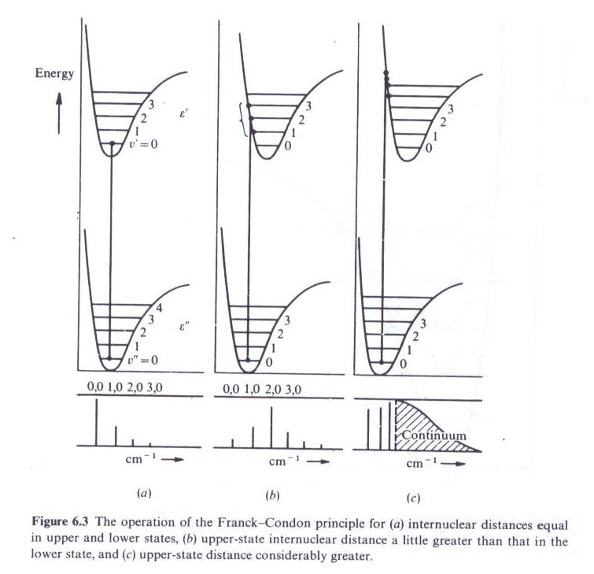

ENGINEERING CHEMISTRY
Module I- Molecular Spectroscopy
r_{e}” and r_{e}’ are the internuclear distances of the ground and excited states respectively
Three possibilities of vibrational - electronic transitions exist
Internuclear distance of excited state is more than than that of ground state r_{e}” < r_{e}’
The spectrum shows maximum intensity for (v’,0) line where v’ is the vibrational level in the excited state to which electronic transition takes place
Source:Fundamentals of Molecular Spectroscopy: C. N. Banwell and Elaine M McCash, Fifth Edition, MCGRAW-HILL Education (India) Private Ltd.

Slide 8
ENGINEERING CHEMISTRY
Module I- Molecular Spectroscopy
No change in internuclear distance
r_{e}”= r_{e}’
The spectrum shows maximum intensity for (0,0) line and intensity falls for the remaining lines
Source:Fundamentals of Molecular Spectroscopy: C. N. Banwell and Elaine M McCash, Fifth Edition, MCGRAW-HILL Education (India) Private Ltd.

Slide 9
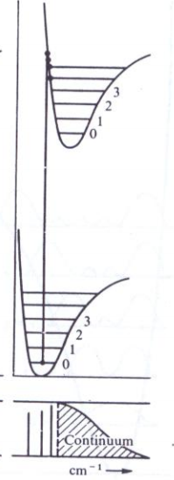
ENGINEERING CHEMISTRY
Module I- Molecular Spectroscopy
Internuclear distance of excited state is considerably greater than than that of ground state r_{e}” << r_{e}’
The spectrum shows continuum since the transition results in the molecule going beyond dissociation energy. The molecule dissociates into atoms which gain kinetic energy. Since this energy is not quantised a continuum is seen in the spectrum
Source:Fundamentals of Molecular Spectroscopy: C. N. Banwell and Elaine M McCash, Fifth Edition, MCGRAW-HILL Education (India) Private Ltd.

Slide 10
ENGINEERING CHEMISTRY
Module 1- Molecular Spectroscopy
1. Calculate the rotational constant for an NO molecule. Given atomic masses of N and O are 14.004 amu and 15.9994 amu respectively. The bond length of NO is 115 pm.
(1 amu = 1.66 x 10⁻²⁷ kg, c = 3 x 10⁸ ms⁻¹, h=6.6x 10⁻³⁴ Js)
Solution:

Slide 11
ENGINEERING CHEMISTRY
Module 1- Molecular Spectroscopy
2. The first line in the pure rotational spectrum of HCl appears at 21.18 cm⁻¹ . Calculate the bond length of the molecule. Given atomic masses of H and Cl are 1.008 amu and 35.45 amu respectively.
(1 amu = 1.66 x 10⁻²⁷ kg, c = 3 x 10⁸ ms⁻¹, h = 6.6x 10⁻³⁴ Js)
Solution :

Slide 12
ENGINEERING CHEMISTRY
Module 1- Molecular Spectroscopy

Slide 13
ENGINEERING CHEMISTRY
Module 1- Molecular Spectroscopy
3. For HBr molecule:
i) The rotational spectrum shows the first line at 17.19 cm⁻¹. Calculate the bond length of HBr molecule( Use rigid rotor model)
ii) The vibrational spectrum shows fundamental and first overtone at 2559.08 cm⁻¹ and 5027.54 cm⁻¹ respectively. Calculate the anharmonicity constant for the molecule. (Use anharmonic oscillator model). (1 amu = 1.66 x 10⁻²⁷ kg, h = 6.627 x 10⁻³⁴ Js, c = 3 x 10¹⁰cms⁻¹ , N = 6.023 x 10²³ mol⁻¹, Gram molar mass of H = 1.0 and Br = 79.9 )
Solution :
i) 2B = 17.19 cm⁻¹ B = 8.595 cm⁻¹

Slide 14
ENGINEERING CHEMISTRY
Module 1- Molecular Spectroscopy
ii)

Slide 15
ENGINEERING CHEMISTRY
Module 1- Molecular Spectroscopy
4. For a KCl molecule undergoing simple harmonic motion the vibrational spectrum shows a fundamental frequency at 378 cm⁻¹.
i) Calculate the reduced mass of KCl ii) Determine force constant of KCl iii) Determine zero point energy for KCl molecule. (c = 3 x 10¹⁰ cms⁻¹ , N = 6.023 x 10²³ mol⁻¹, Gram molar mass of K = 39 and Cl = 35.5)
Solution :

Slide 16
ENGINEERING CHEMISTRY
Module 1- Molecular Spectroscopy
5. The force constant of CO is 1840 Nm⁻¹. Calculate the oscillation frequency and wave number in cm⁻¹. (1 amu = 1.66 x 10⁻²⁷ kg,
c = 3 x 10⁸ ms⁻¹, Gram molar mass of C = 12.000 and O = 15.9994)
Solution :

Slide 17
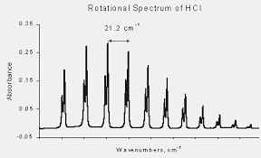
ENGINEERING CHEMISTRY Rotational Spectrum of HCl
https://www.google.com/url?sa=i&url=https%3A%2F%2Fwww.physics.dcu.ie%2F~be%2FPs415%2FRotational1.pdf&psig=AOvVaw3MLionOfGJ5e6yIpw6oCRB&ust=1694589411993000&source=images&cd=vfe&opi=89978449&ved=0CBIQjhxqFwoTCMio8bbGpIEDFQAAAAAdAAAAABAD

Slide 18
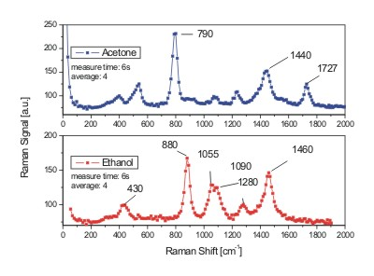
ENGINEERING CHEMISTRY Raman Spectra of Acetone and Ethanol
https://www.google.com/url?sa=i&url=https%3A%2F%2Fwww.sacher-laser.com%2Fapplications%2Foverview%2Framan_spectroscopy%2Facetone.html&psig=AOvVaw36wm4omX2vR8WMuwzO35Ds&ust=1694590203024000&source=images&cd=vfe&opi=89978449&ved=0CBEQjhxqGAoTCOjlpczGpIEDFQAAAAAdAAAAABCTAQ

Slide 19
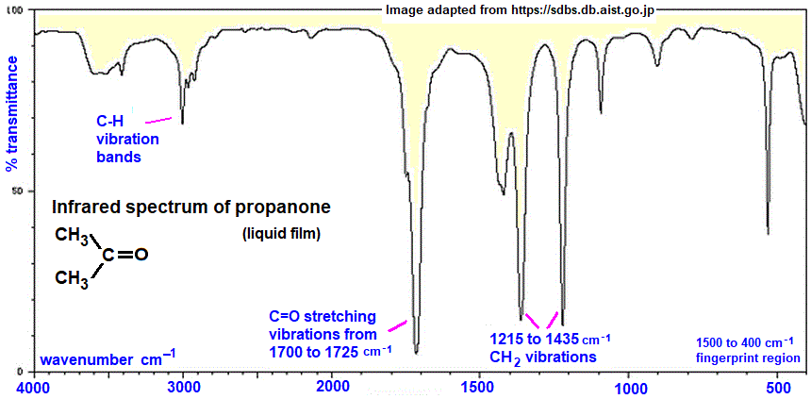
ENGINEERING CHEMISTRY IR spectra of Acetone

Slide 20
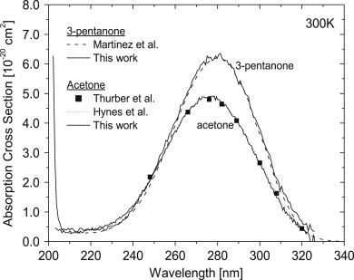
ENGINEERING CHEMISTRY Electronic Spectra of Acetone
https://www.google.com/url?sa=i&url=https%3A%2F%2Fwww.sciencedirect.com%2Fscience%2Farticle%2Fpii%2FS0022407308000307&psig=AOvVaw3ysyw2bsVZ-8HdKyPc1r-L&ust=1694589528200000&source=images&cd=vfe&opi=89978449&ved=0CBIQjhxqFwoTCOD96IvEpIEDFQAAAAAdAAAAABAf

Slide 21
ENGINEERING CHEMISTRY
Module I- Molecular Spectroscopy
END OF MODULE 1 – MOLECULAR SPECTROSCOPY

Slide 22
THANK YOU
Asha A
Department of Science and Humanities

